Slide 1
1.4 Expressions and Assignment Statements

Slide 2
Expression
A combination of constants, variables, operators that evaluate to a value
Examples
11 * 3 + 5 - 8 / 4
100
int x = 10;
x * 10

Slide 3
Relational Operators
Operator | Meaning | Example
== | equal to | x == 100
!= | not equal to | age != 21
> | greater than | average > 30
< | less than | grade < 65
>= | greater than or equal | age >= 18
<= | less than or equal | height <= 6

Slide 4
Assignment vs Equals
Assignment
Equality
x = 0
x == 0
x 0

Slide 5
Arithmetic Operators
Operator | Meaning | Example
+ | addition | 3 + x
- | subtraction | p - q
* | multiplication | 6 * i
/ | division | 10 / 4
% | mod (remainder) | 11 % 3

Slide 6
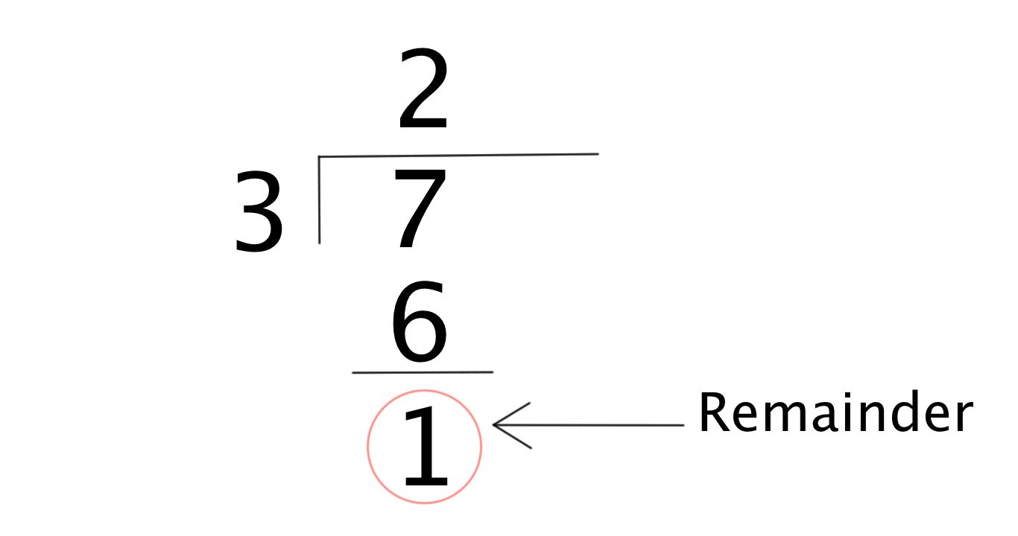
Modulus
Modulus gives the remainder to an equivalent division problem.
7 % 3
4 % 2
3 % 5
== 1
== 0
== 3

Slide 7

Order of Operations
Java evaluates expressions according to standard mathematical rules of precedence.
PEMDAS
Parentheses
Exponent (ignore this for now)
Multiply / Divide / Modulus
Addition / Subtraction
Note that Java evaluates expressions from left to right and from top to bottom.

Slide 8
Integer Division
Dividing two int values always results in a single int
(always truncated: rounded down)
10 / 2 = 5
15 / 2 = 7
19 / 10 = 1
Dividing with a double results in a double
15 / 2.0 = 7.5

Slide 9
Double Division
int x = 9;
int y = 2;
double z = 1.0 * x / y;

Slide 10
The String Concatenation Operator (+)
Same symbol as addition
Used to combine strings and other data types into strings
Examples
"hello " + " friend" == "hello friend"
"your score: " + 100 == “your score: 100"
88.6 + " degrees" == "88.6 degrees"

Slide 11
String Concatenation
Once Java starts working with Strings, it continues to look at thing as strings and interpret “+” operator as string concatenation operator.
Examples
"Lucky number: " + 4 + 2
4 + 2 + " is lucky"
== "Lucky number: 42"
== "6 is lucky"

Slide 12
Practicing variable assignment
Open the repl.it project called ToCelsius
Inside main(), define and initialize the temperature in Fahrenheit as a variable f
Your program should then convert this to a temperature in degrees Celsius
You should then print “f degrees Fahrenheit is c degrees Celsius” for the values of f and c
Remember that to convert Fahrenheit to Celsius, you need to subtract 32 and then multiply by 5/9
*use comments!!

Slide 13
More practice
Open the repl.it project addFrac
Inside main() define and initialize four integers: the numerator and denominator of the first fraction, and the numerator and denominator of the second fraction
Your program should then print these fractions, e.g.
“The first fraction is 5/9”
“The second fraction is 2/3”
Your program should then compute the sum of these fractions. The sum does not need to be in reduced form
Recall that a/b + c/d = (a*d)/(b*d) + (c*b)/(d*b) = (ad + bc)/(db)
Your program should then print this sum:
“The sum of the fractions is 33/27”

